Slide 1
Ecommerce Support Systems
Technical Architecture / Target Operation Model

Slide 2
Release Model (2010)

Slide 3
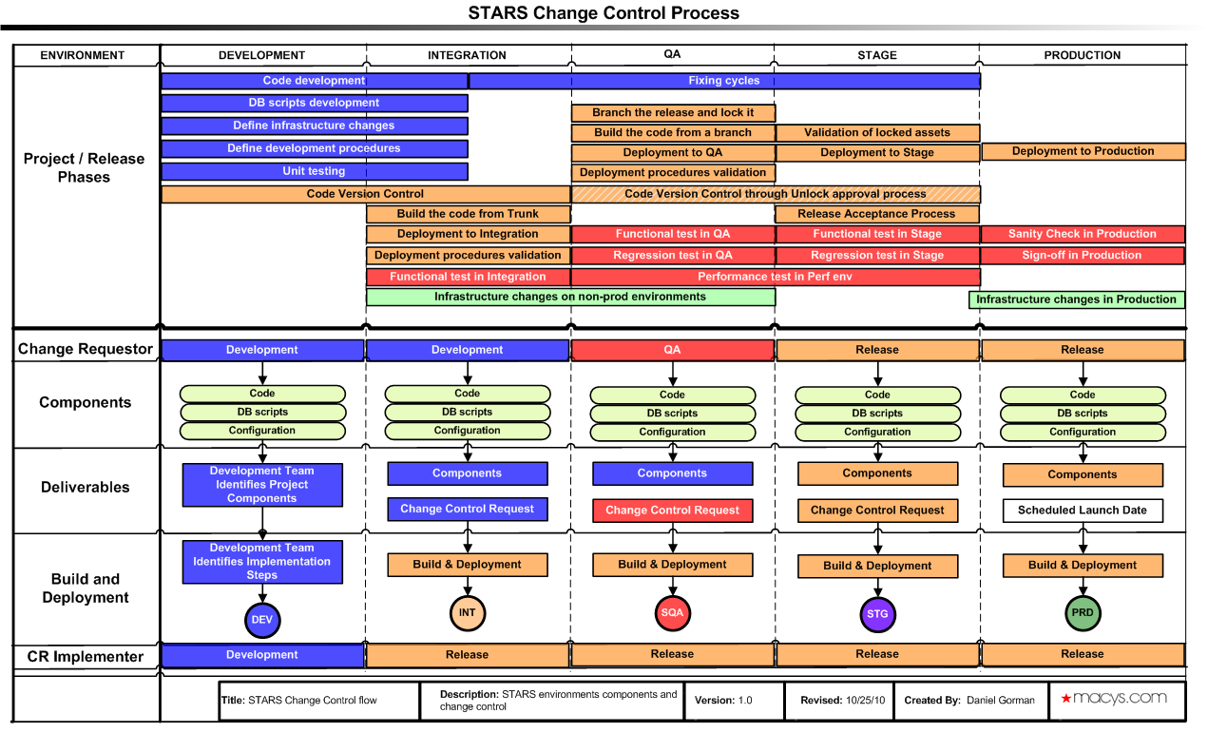
Release Phases and Change Control

Slide 4
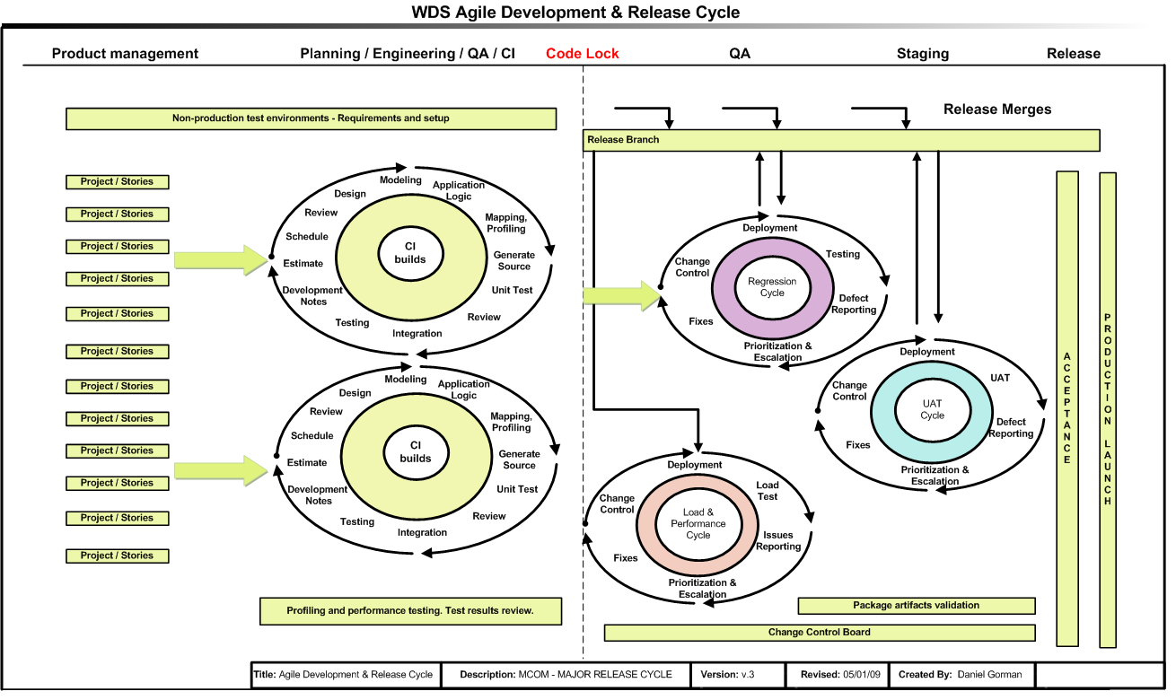
2010 WDS Operating Delivery Model

Slide 5
DevOps Transformation Design Patterns
Offer a neutral language for designing and implementing technology-enabled operational model
Offer an engineering approach that reduces design and implementation duration and effort

Slide 6
Steps in Transitioning to DevOps on-demand delivery
Think holistic and cross-functional, not only IT
Make it Agile, flexible and speedy
Deliver changes as small, discrete, and self-contained units
Unify infrastructure across the delivery pipeline
Apply TDD / BDD principles
PaaS Platform: Cloud(AWS) infrastructure as code and DevOps Tools

Slide 7
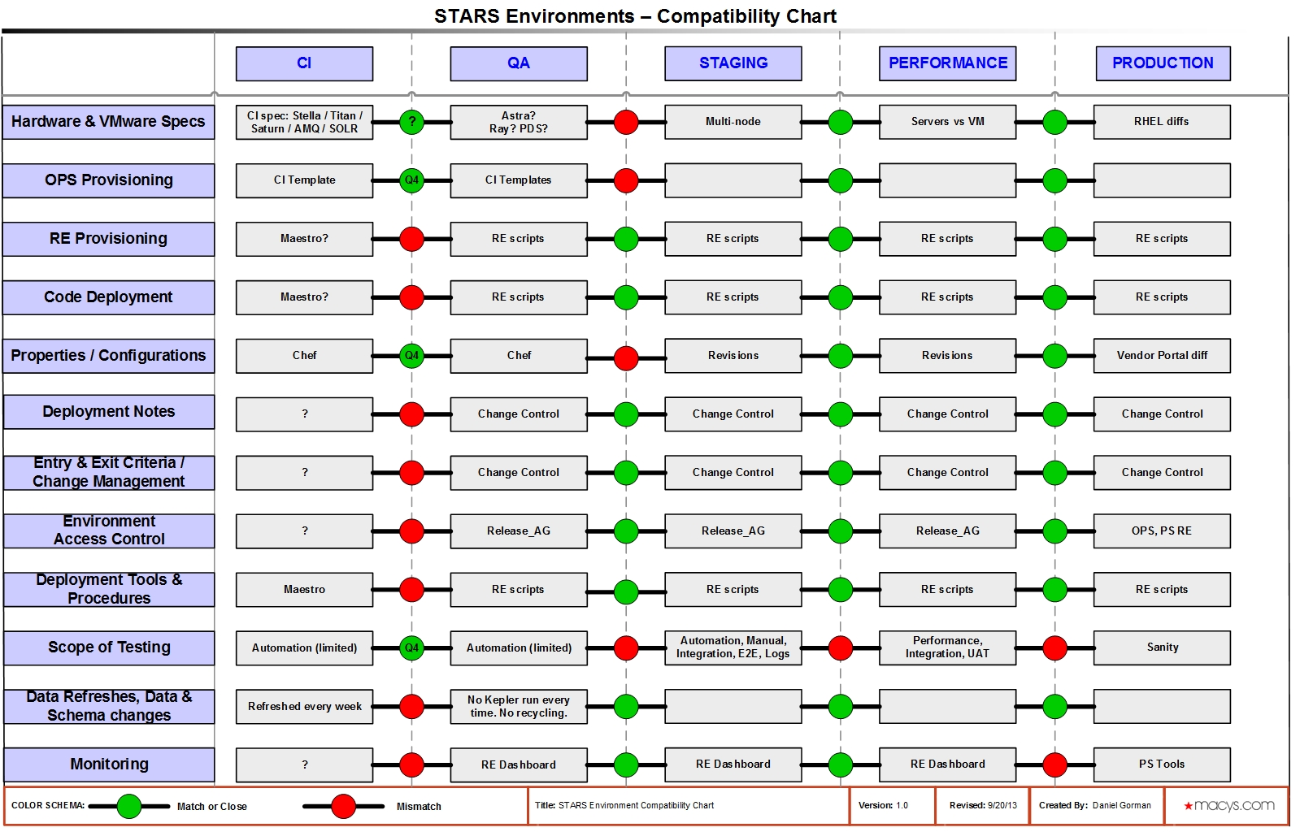
Transitioning phase (Components)

Slide 8
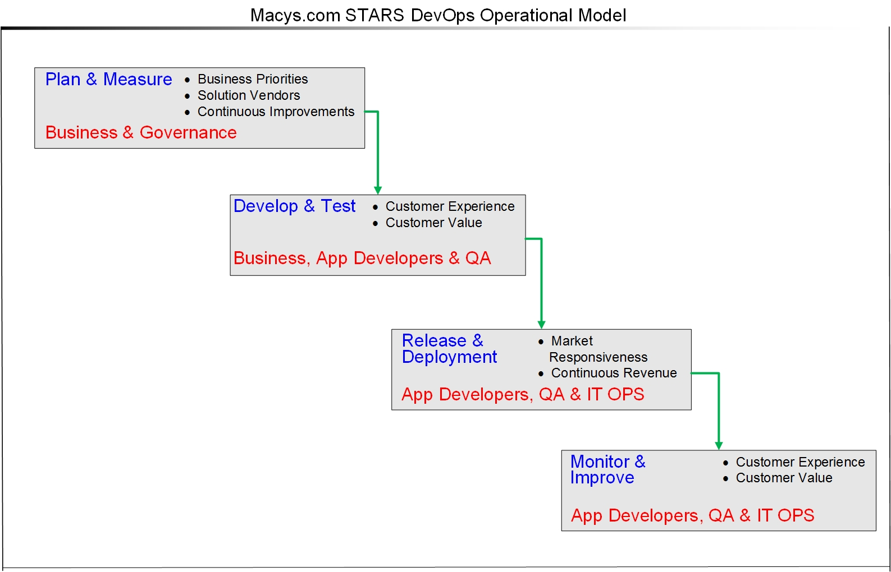
DevOps Operational Model

Slide 9
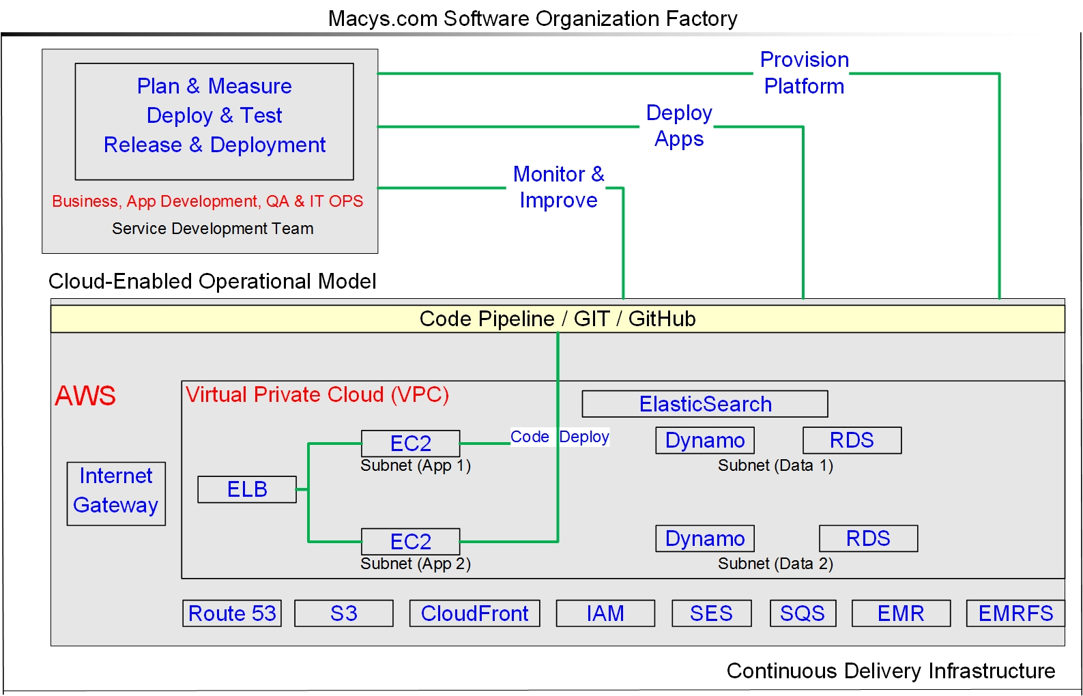
AWS-based PaaS and CD Infrastructure

Slide 10
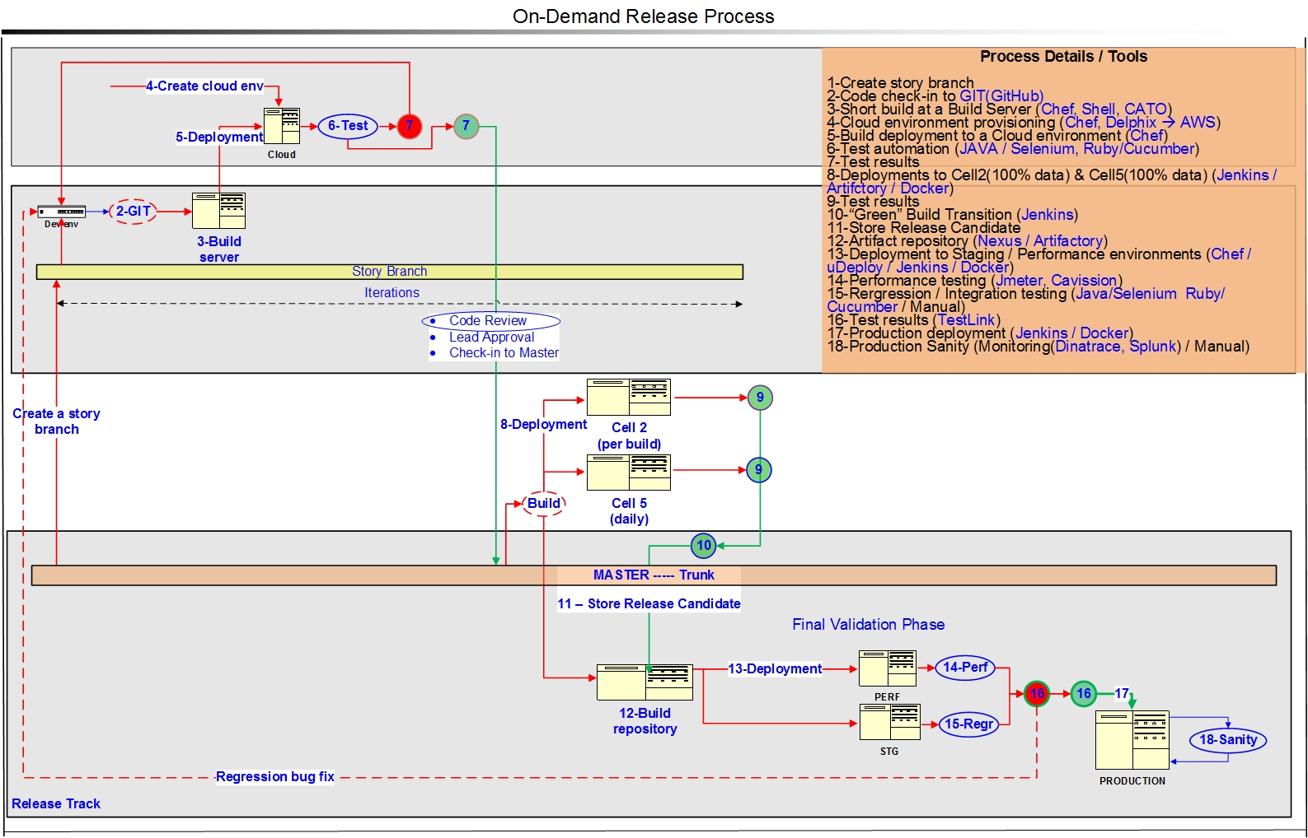
DevOps Operational Model – Agile development Structure

